Slide 1

WEB Development
Grade 7&8

Slide 2
Recap of the last Class
Notes:
Objective:
Review the previous lesson on Navigation and Hero Section.
Introduce the new topic: Scroll Animation.
Teacher Instructions:
Navbar:
Recap the purpose of a navbar and its importance in providing easy access to different sections of a website.
Emphasis on User Experience:
Discuss how a well-designed navbar improves user experience by making navigation intuitive and straightforward.
Explain how an intuitive navbar can help a website to grow by retaining users and encouraging them to explore more content.
Hero Section:
Recap the purpose of the hero section as the prominent, eye-catching part of a webpage, usually located at the top.
Explain its role in grabbing the user's attention and communicating the primary message or call to action.
Introduce today's topic:
Scroll Animation:
Learning About Scroll Animation:
Introduce the concept of scroll animations and their purpose in enhancing the user experience by adding visual interest.
Explain how scroll animations can make a website more engaging and interactive.
Crafting the "Go Green" Page:
Outline the steps to create a "Go Green" webpage with an interactive hero section and scroll animations.

Slide 3
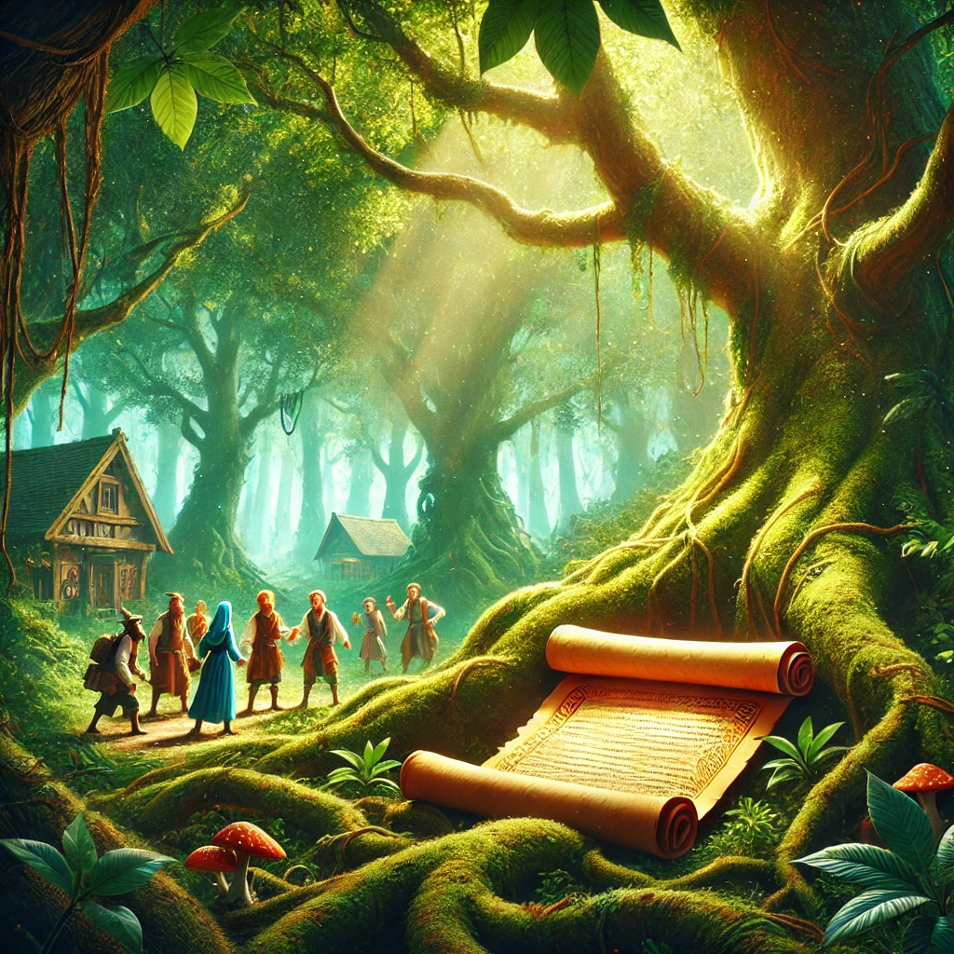
The EcoVille Mystery
In the heart of EcoVille, there was a mysterious forest that held many secrets about the environment. One day, the townspeople discovered an ancient scroll hidden in the roots of an old tree. The scroll contained a riddle that promised to reveal a crucial secret for protecting the Earth if solved:
"I am not alive, but I can grow; I don’t have lungs, but I need air; I don’t have a mouth, and I can drown. What am I?"
The townspeople were puzzled and turned to the clever students of EcoVille. Can you help solve the riddle and uncover the secret to saving the environment?
The townspeople were puzzled and turned to the clever students of EcoVille. Can you help solve the riddle and uncover the secret to saving the environment?
Notes:
Objective:
Introduce the Riddle Story:
Read aloud:
"In EcoVille, an ancient scroll was found with a riddle:
'I am not alive, but I can grow; I don’t have lungs, but I need air; I don’t have a mouth, and I can drown. What am I?'
Can you solve the riddle to help save the environment?"
Encourage Discussion:
Give students a few minutes to think and discuss in pairs or groups.
Walk around to listen and provide hints.
Facilitate the Solution:
Ask students to share their answers.
Reveal the answer: "A plant."
Connect to the Lesson:
Explain the importance of plants in the "Go Green" initiative.
Relate the riddle to creating engaging content for their "Go Green" website.

Slide 4
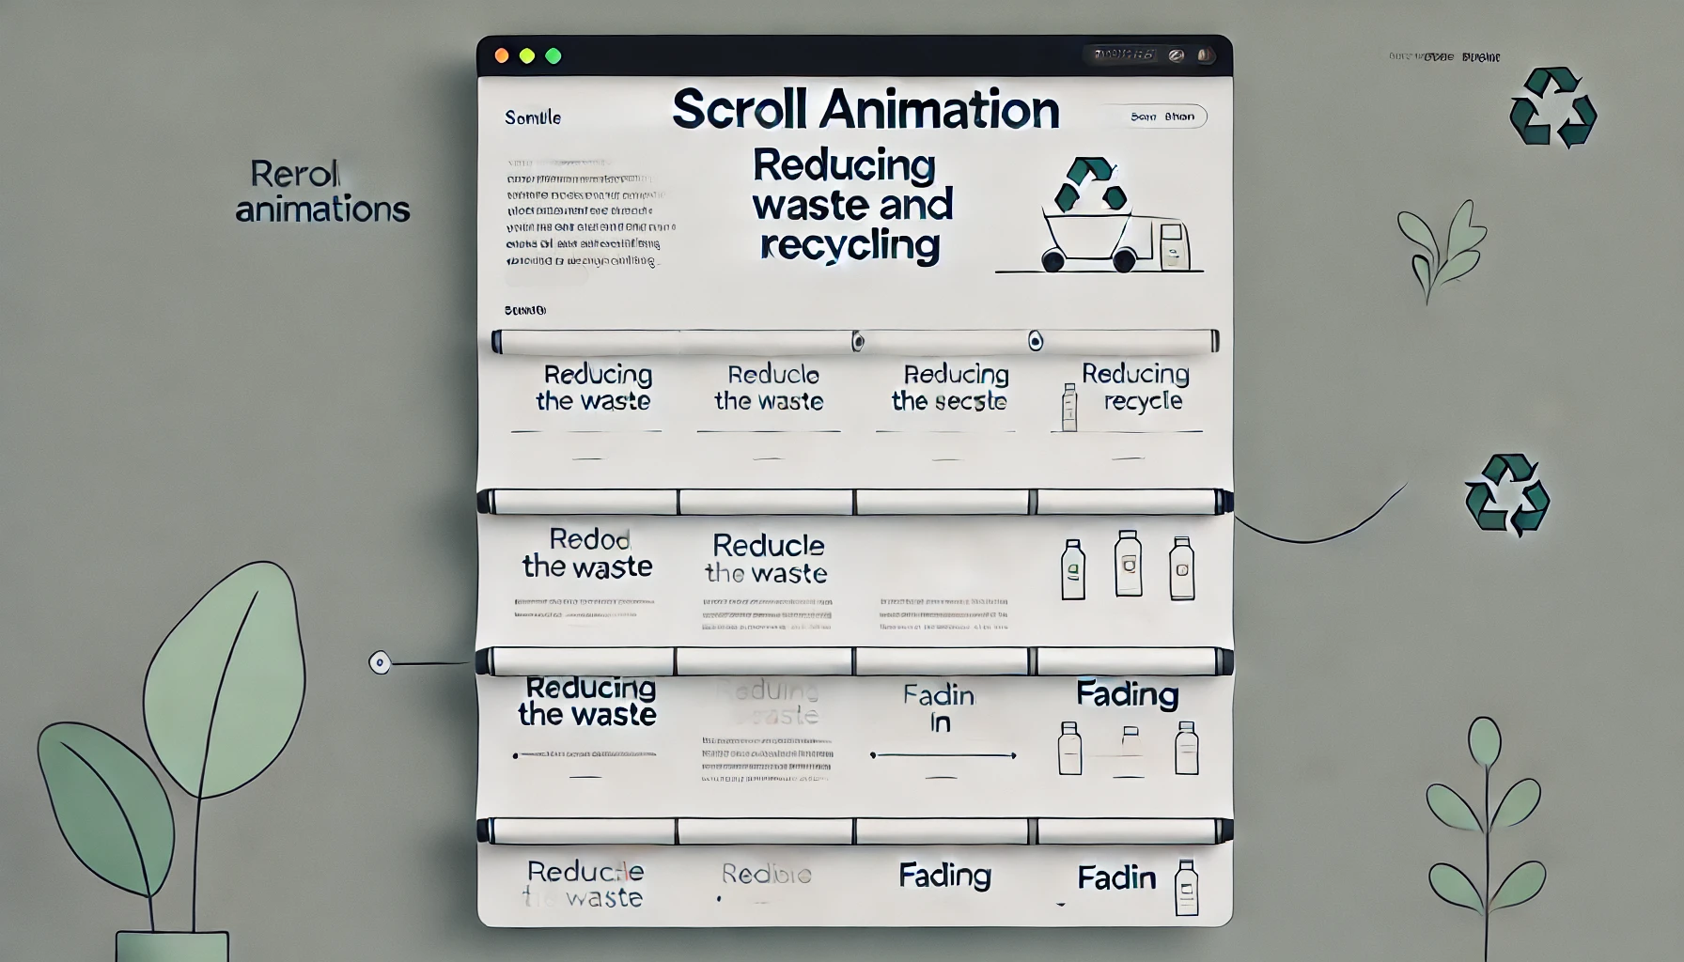
Introduction to Go Green Webpage and Scroll animation
Notes:
Objective:
Introduce the concept of navigation and hero sections in web design.
Teacher Instructions:
Introduction to Scroll Animations:
Purpose: Explain how scroll animations capture attention and enhance user experience.
Basic Techniques: Introduce simple CSS animations (e.g., sliding in from the sides, fading in).

Slide 5
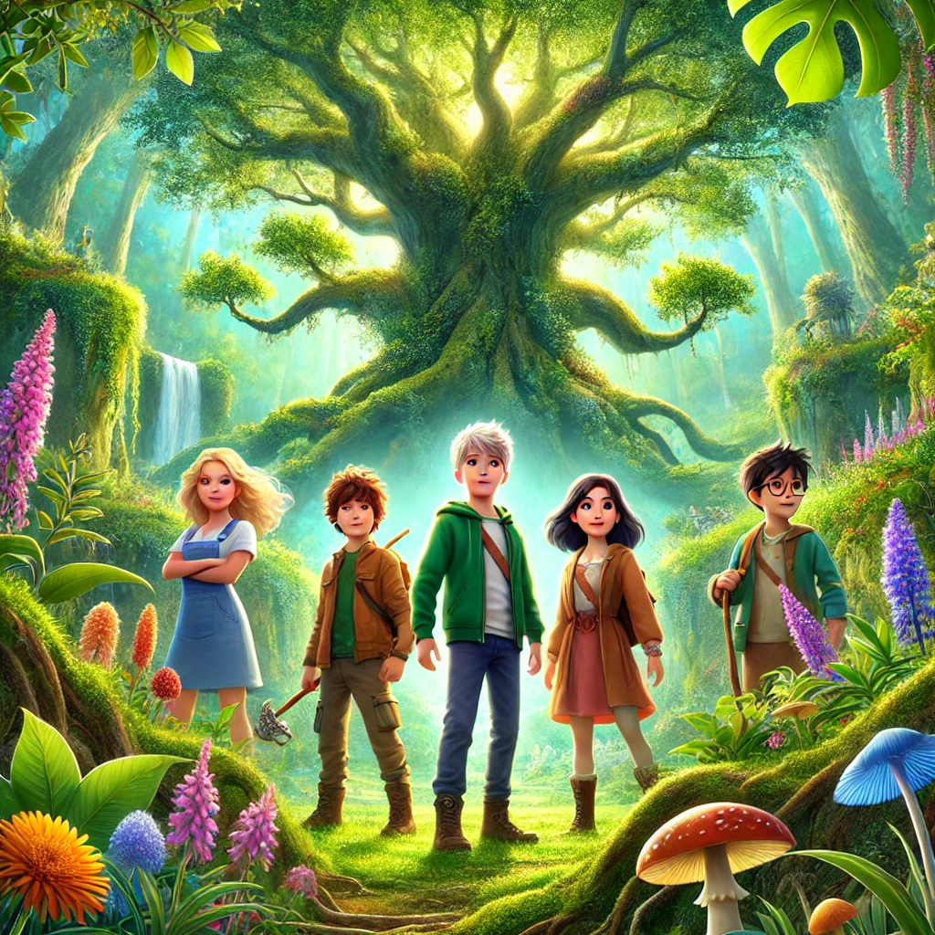
The Green Guardians and the Forest of Change
In EcoVille, the Green Guardians—Lily, Ben, Mia, and Leo—loved nature. One day, the ancient Wisdom Oak whispered, "Help the Forest of Change." They met Gaia, the Guardian, who needed their help to clean the river, plant trees, and raise awareness about the environment. The friends eagerly took action to save the forest.
Riddle: How Can Lily, Ben, Mia, and Leo Raise Awareness in a Digital Space?
Notes:
Teacher Instructions
Objective:
Engage students with a visual story.
Reinforce the "Go Green" theme.
Instructions:
Show the Image:
Display the image of the Green Guardians.
Read the Story:
"In EcoVille, the Green Guardians—Lily, Ben, Mia, and Leo—loved nature. The Wisdom Oak whispered, 'Help the Forest of Change.' Gaia needed their help to clean the river, plant trees, and raise awareness."
Introduce the Challenge:
Create a "Go Green" website:
Homepage: Navbar and interactive hero section.
Information: Sections on reducing waste, recycling, and conserving water.
Animations: Use scroll animations.
Engage students in brainstorming and starting their website project.

Slide 6
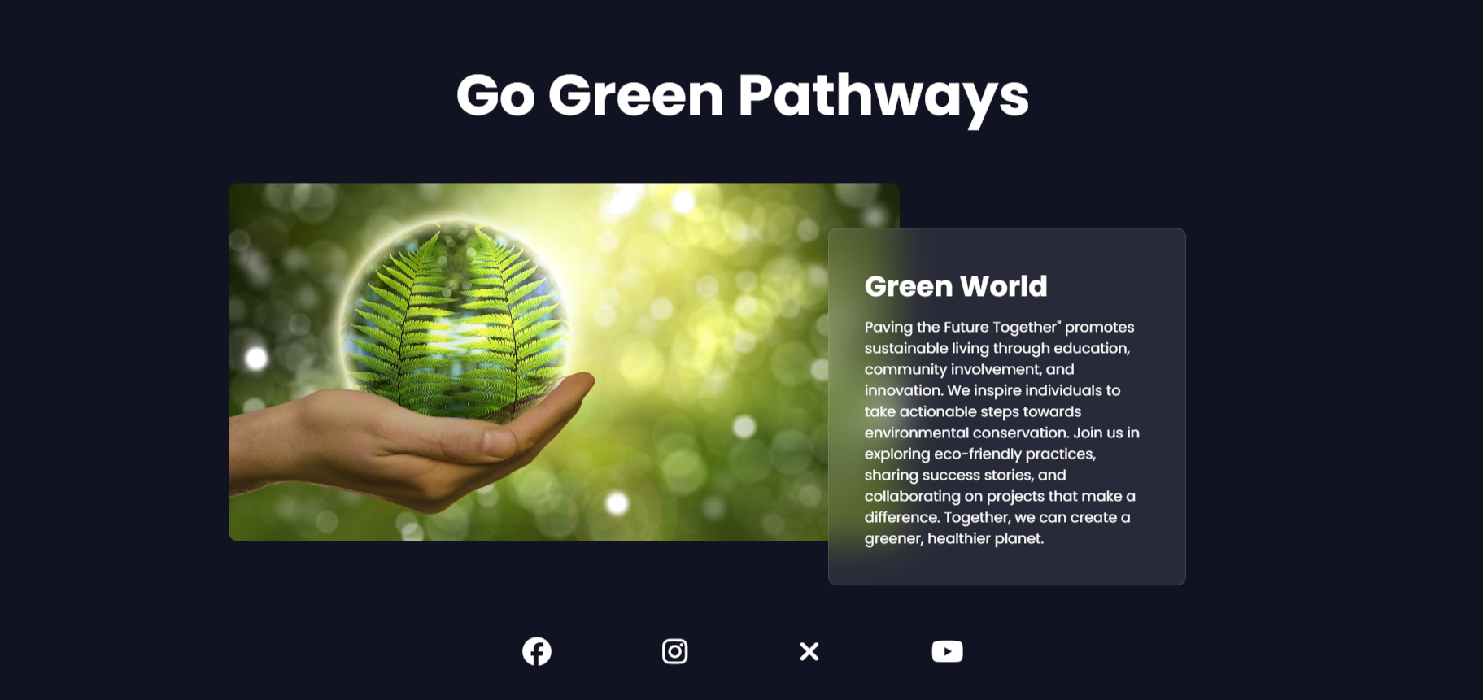
Project – Go Green Pathways: Paving a Sustainable Future
Notes:
Project Link: Go Green Pathways
Objective:
Present the final project example.
Teacher Instructions:
Show the Screenshot:
Display the screenshot of the final project example.
Show the Project in Live Action:
Demonstrate the project on a live website to show how it functions.
Navigate through the website to showcase the scroll effect in action.
Emphasize the importance of both elements in creating an engaging and easy-to-use website.
Explain the Project:
Inform students that they will create a similar project.
Highlight the key features:
A clear and user-friendly hero section.
An engaging webpage using scroll animation.

Slide 7
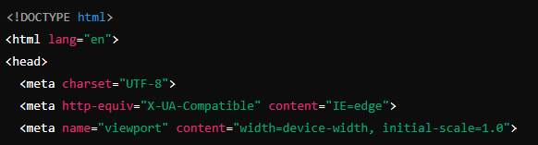
Working with the Project
HTML Code Explanation
Basic Structure of an HTML Document
Notes:
"Teacher's Activity"
Project Link: Go Green Pathways
Objective:
Explain the basic structure of an HTML document.
Teacher Instructions:
Display the screenshot of the HTML code.
Provide an overview of the basic structure:
<!DOCTYPE html>: Specifies the HTML version (HTML5).
<html lang="en">: Sets the language of the document to English.
<meta charset="UTF-8">: Defines the character encoding as UTF-8.
<meta http-equiv="X-UA-Compatible" content="IE=edge">: Ensures compatibility with older versions of Internet Explorer.
<meta name="viewport" content="width=device-width, initial-scale=1.0">: Makes the page responsive by controlling the viewport's size and scale.

Slide 8
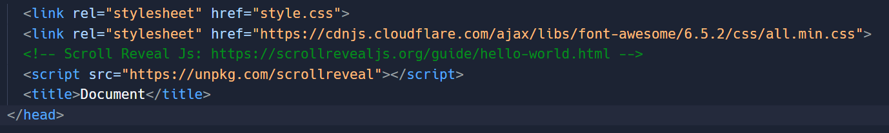
Working with the Project
Linking External CSS and JavaScript:
Notes:
Teacher Instructions:
Project Link: Go Green Pathways
Display the screenshot of the HTML code.
Provide an overview of the linking external library
Scroll Reveal Js library link: https://scrollrevealjs.org/guide/hello-world.html
Tag Explanation:
<link rel="stylesheet" href="style.css">: Links to an external CSS file for styling.
<link rel="stylesheet" href="https://cdnjs.cloudflare.com/ajax/libs/font-awesome/6.5.2/css/all.min.css">: Links to Font Awesome for icons.
<script src="https://unpkg.com/scrollreveal"></script>: Links to the Scroll Reveal JavaScript library for adding scroll animations.
<title>Document</title>: Sets the title of the document (appears in the browser tab).

Slide 9
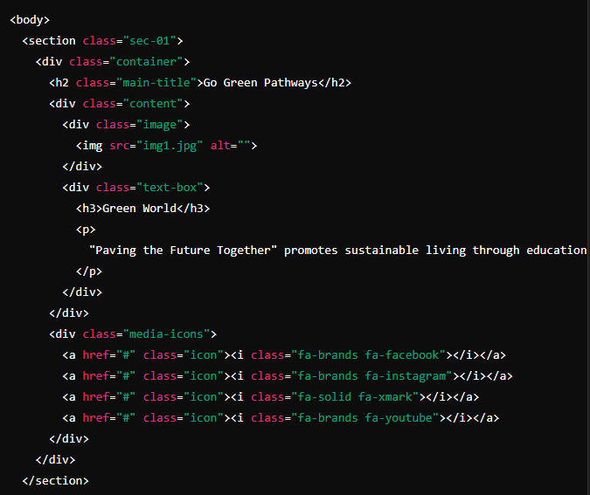
Working with the Project
Body Content and Section 1: Go Green Pathways
Notes:
Objective:
Hero Section:
Project Link: Go Green Pathways
Captures visitors' attention immediately.
Teacher Instructions:
Show how the section 1 looks and functions on a live website.
Demonstrate the impact of a strong and appealing Hero Section.
Tag Explanation:
<body>: Starts the body section of the document where content is placed.
<section class="sec-01">: Defines the first section with the class "sec-01".
<div class="container">: A container div that groups content within the section.
<h2 class="main-title">Go Green Pathways</h2>: The main title of the section.
<div class="content">: A div grouping the main content.
<div class="image">: A div containing an image.
<img src="img1.jpg" alt="">: The image element.
<div class="text-box">: A div containing text content.
<h3>Green World</h3>: A sub-title.
<p>: A paragraph of text.
<div class="media-icons">: A div for social media icons.
<a href="#" class="icon"><i class="fa-brands fa-facebook"></i></a>: A link with a Facebook icon.

Slide 10
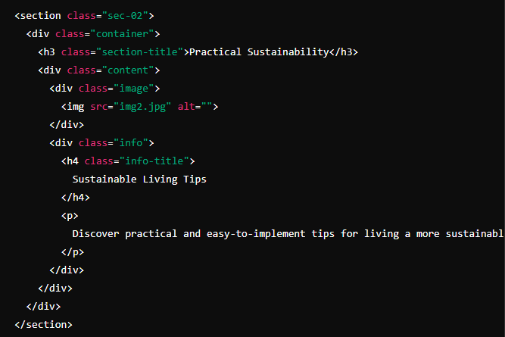
Section 2: Practical Sustainability
Notes:
Objective:
Teacher Instructions:
Project Link: Go Green Pathways
Show how the section 2 looks and functions on a live website.
Demonstrate the impact of a strong and appealing Secondary Section.
Tag Explanation:
<section class="sec-02">: Defines the second section with the class "sec-02".
<h3 class="section-title">Practical Sustainability</h3>: The title of the second section.
<div class="image">: A div containing an image.
<img src="img2.jpg" alt="">: The image element.
<div class="info">: A div containing additional information.
<h4 class="info-title">Sustainable Living Tips</h4>: A sub-title.
<p>: A paragraph of text.

Slide 11
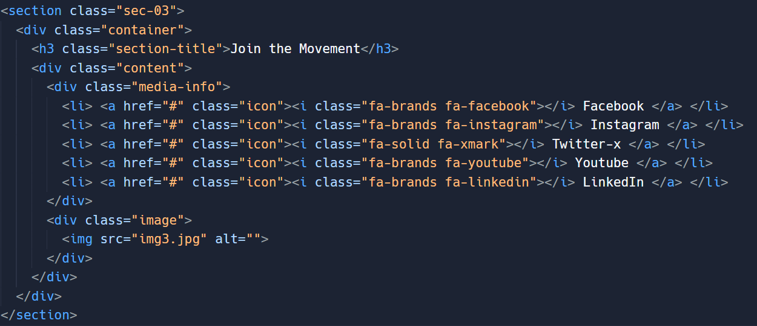
Section 3: Join the Movement
Notes:
Objective:
Teacher Instructions:
Show how the section 3 looks and functions on a live website.
Demonstrate how to add icons from font awesom website https://fontawesome.com/search
Tag Explanation:
<section class="sec-03">: Defines the third section with the class "sec-03".
<h3 class="section-title">Join the Movement</h3>: The title of the third section.
<div class="media-info">: A div containing media information.
<li> <a href="#" class="icon"><i class="fa-brands fa-facebook"></i> Facebook </a> </li>: List items with social media links and icons.
<div class="image">: A div containing an image.
<img src="img3.jpg" alt="">: The image element.

Slide 12
Html Structure Done
Let's Style it Now
Notes:
Objective:
Review the code till now
Project Link: Go Green Pathways
Teacher Instructions:
Recap the key points.
Encourage interactive discussion and exploration of each tag.

Slide 13
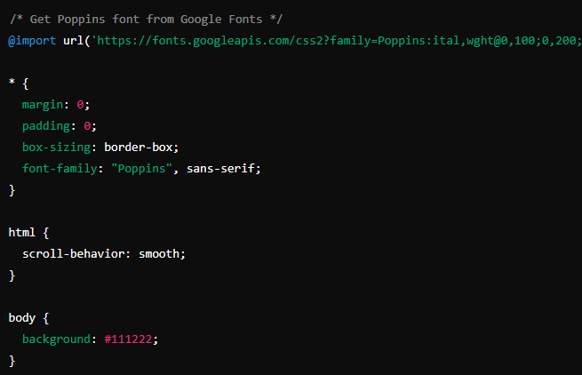
Working with the Project
CSS Code Explanation:
Adding Scroll behavior and Global selector:
Notes:
Objective:
Project Link: Go Green Pathways
Explain Global Styles:
Explain the importance of global styles for consistency using the universal selector *.
Discuss the use of @import for fonts and setting font families.
Introduce to Google Font website https://fonts.google.com/
Teacher Instructions:
Display the screenshot of the CSS code.
Explain the styling for the header:
position: fixed;: Keeps the header fixed at the top of the page.
top: 0; left: 0; width: 100%;: Ensures the header spans the full width of the page.
padding: 10px 100px;: Adds padding for spacing.
background: transparent;: Sets a transparent background.
display: flex; justify-content: space-between; align-items: center;: Uses flexbox for layout.
z-index: 100;: Ensures the header stays on top of other elements.

Slide 14
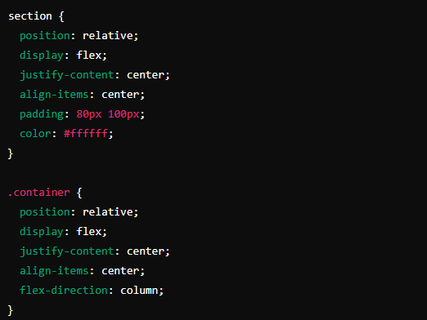
Working with the Project
Section and Container Styles:
Notes:
Objective:
Explain the CSS code for styling the container and section.
Teacher Instructions:
Code Explanation:
section: Styles for all section elements.
position: relative;: Sets the position relative to its normal position.
display: flex;: Applies flexbox layout.
justify-content: center;: Centers content horizontally.
align-items: center;: Centers content vertically.
padding: 80px 100px;: Adds padding inside the section.
color: #ffffff;: Sets the text color to white.
.container: Styles for container class.
position: relative;: Sets the position relative to its normal position.
display: flex;: Applies flexbox layout.
justify-content: center;: Centers content horizontally.
align-items: center;: Centers content vertically.
flex-direction: column;: Arranges children in a column.

Slide 15
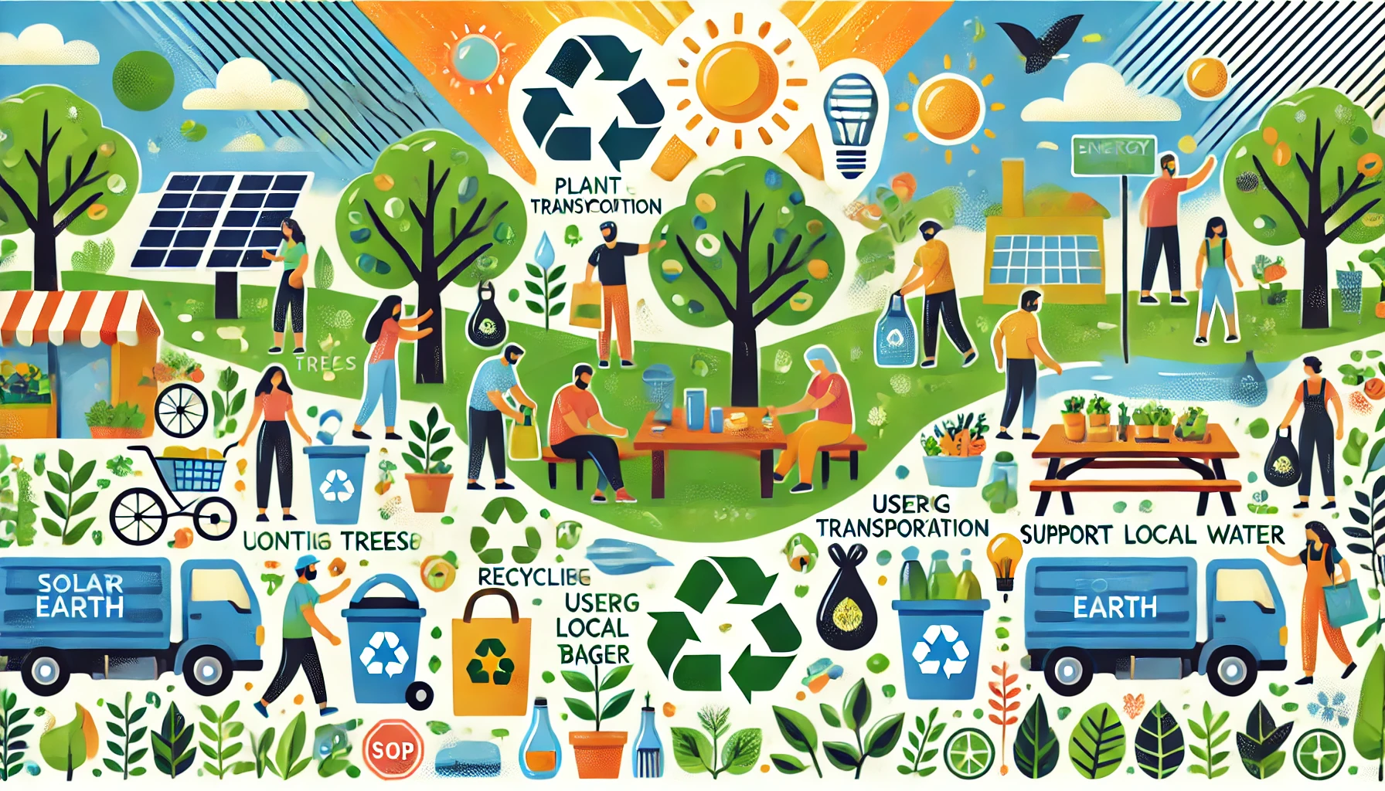
Now it's your turn!
Task:
try to add one more section to show how citizens can help mother earth
Instructions: Share the code with others and work as a group to give your own personalization to the final web page.
Notes:
"Students' Activity"
Objective:
Allow students to use their creativity in designing the Help Mother Earth section
Teacher Instructions:
Present the student activity task
Instruct student's to complete it
Discuss the importance of small action and how it can change things in a bigger picture
Try to Discuss following points which will help them to create their project
Reduce, Reuse, Recycle: Minimize waste by reducing consumption, reusing items, and recycling materials like paper, plastic, and glass.
Conserve Water: Turn off taps while brushing, take shorter showers, and fix leaks promptly.
Save Energy: Turn off lights and electronics when not in use, use energy-efficient bulbs, and consider renewable energy sources.
Choose Sustainable Products: Opt for eco-friendly products and support companies that prioritize sustainability.
Plant Trees and Gardens: Trees absorb carbon dioxide and provide oxygen, while gardens support local wildlife and help combat climate change.
Use Public Transport: Reduce your carbon footprint by using public transportation, biking, or walking instead of driving.
Reduce Plastic Use: Use reusable alternatives to single-use plastics, like bottles, bags, and utensils.
Support Local and Organic: Buy local produce and organic foods to reduce your carbon footprint and avoid harmful pesticides.
Educate and Advocate: Spread awareness about environmental issues and support policies that protect the planet.
Compost: Composting reduces landfill waste and provides nutrient-rich soil for gardening.

Slide 16

How to Save & Share the project.
Replit offers autosave option – so not worry about the same.
To share project with someone in view mode: just copy the link from the URL bar, and share the link
To share the project for collaboration
Click on "Invite" from the top right corner
If you know the username, type it in the box and click on invite
You can also turn on the toggle button "private join link" to create a public collaboration link and invite members to edit your code.
Notes:
Instructions for the Teacher:
Explain how to save and share projects on Replit, including the options for collaboration.
Emphasize the importance of sharing projects for feedback and collaboration.

Slide 17


In a Flexbox layout, which CSS property is used to arrange children's elements in a column?
A) flex-direction: row
B) align-items: center
C) flex-direction: column
D) justify-content: center
Notes:
Answer: C) flex-direction: column

Slide 18
Which of the following actions helps reduce your carbon footprint?
A) Using public transport instead of driving.
B) Leaving lights on when not in use.
C) Using single-use plastic products.
D) Taking long showers.
Notes:
Answer: A) Using public transport instead of driving.

Slide 19
What is the backdrop-filter CSS property used for?
A) To change the color of the background.
B) To apply graphical effects such as blurring or color shifting to the area behind an element.
C) To change the font style of text.
D) To adjust the spacing between elements.
Notes:
Answer: B) To apply graphical effects such as blurring or color shifting to the area behind an element.

Slide 20
Which CSS property is used to change the background color of an element?
A) color
B) background-color
C) font-size
D) border
Notes:
Answer: B) background-color

Slide 21

What have we learnt?
What We Learned Today
HTML Basics
DOCTYPE Declaration:
<!DOCTYPE html>
HTML Structure:
<html>, <head>, <body>, <section>, <div>, <h2>, <h3>, <p>, <ul>, <li>, <img>, <a>
Linking External Resources:
<link>, @import, <script>
Notes:
Objective:
Summarize the key learnings from the lesson.
Teacher Instructions:
Review the tags
Ask the student to explain the tags one by one

Slide 22
What have we learnt?
What We Learned Today
CSS Styling
Global Styles:
*, html, body, margin, padding, box-sizing, font-family, background
Flexbox Layout:
display: flex;, flex-direction, justify-content, align-items
Notes:
Objective:
Summarize the key learnings from the lesson.
Teacher Instructions:
Review the css selectors and attributes
Ask the student to explain the attributes one by one or explain by yourself

Slide 23
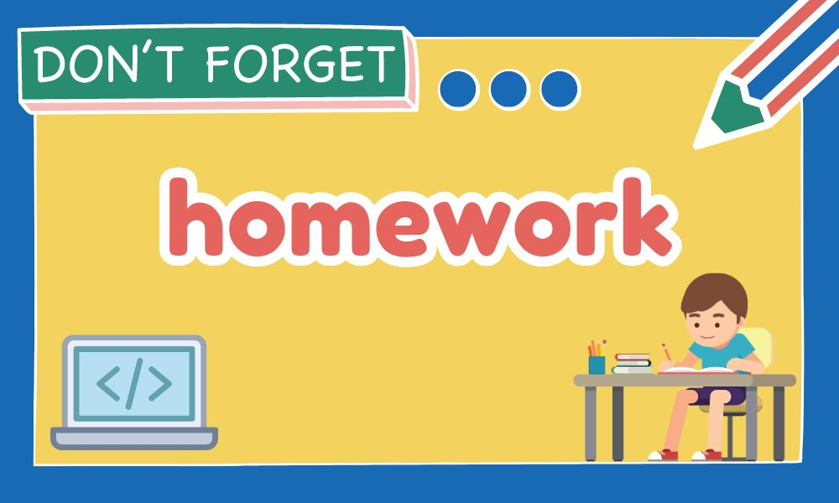
Homework Discussion
Notes:
Instructions for the Teacher: Facilitate a discussion about the homework assignment.

Slide 24
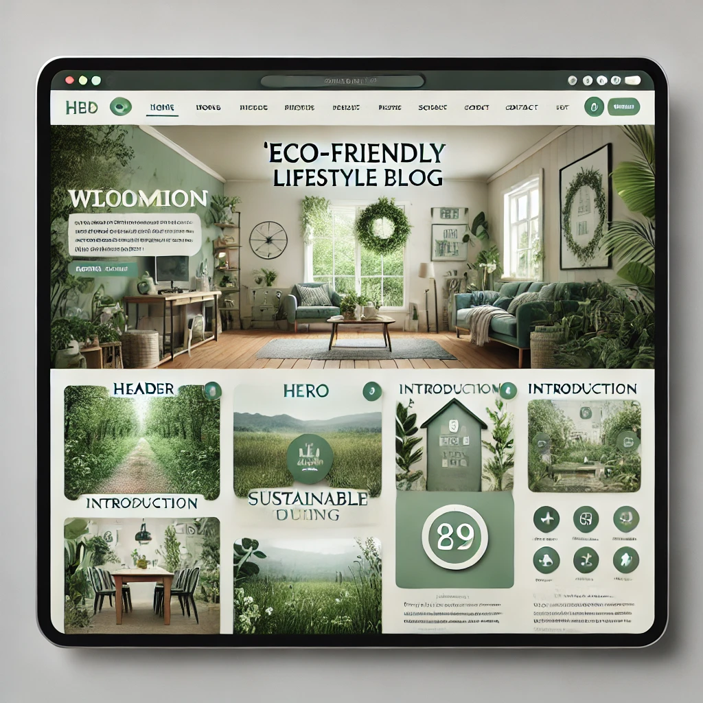
Brain Booster Bonus
Bonus Website Project: "Eco-Friendly Lifestyle Blog".
eco-friendly lifestyle blog. The blog will include multiple sections such as an introduction, tips for living sustainably, a photo gallery, and a contact form.
Notes:
Objective: Instruct the student to create a Eco-Friendly Blog Website While following the below guidelines.
Header
Logo
Navigation Menu (Home, About, Tips, Gallery, Contact)
Hero Section
Large, welcoming image with a headline and subheadline.
Introduction Section
Brief introduction about the purpose of the blog and the author.
Sustainability Tips Section
List of practical tips for living an eco-friendly lifestyle.
Photo Gallery Section
A collection of images showcasing sustainable living.
Contact Section
Simple contact form with fields for name, email, and message.
Footer
Links to social media profiles and copyright information.

Slide 25
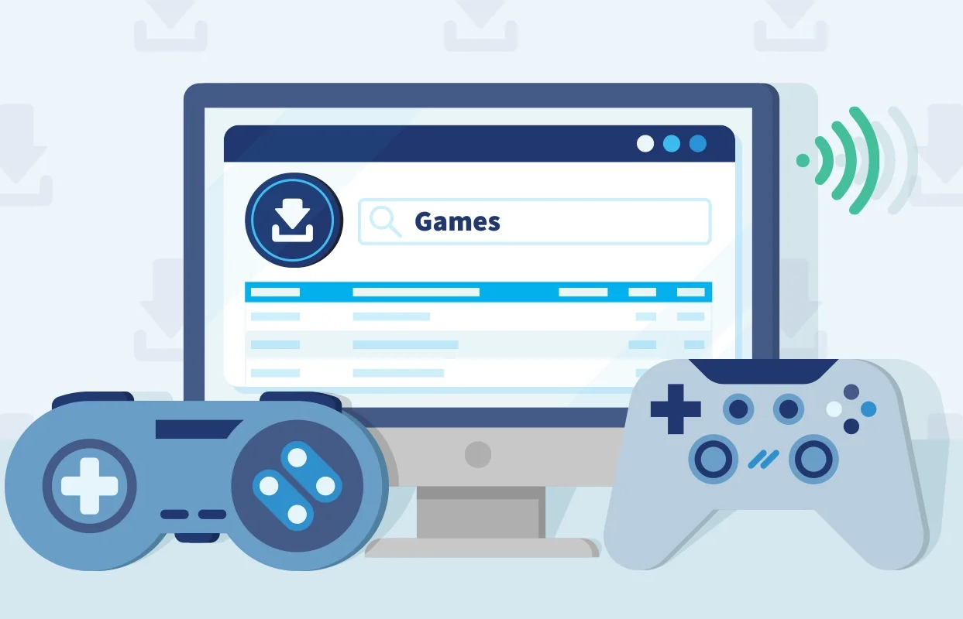
Be Skeptical of Promises
If something online sounds too good to be true, like 'free games for life,' it could be a trick.
Oliver saw an ad online promising "free games for life" and eagerly clicked on it, hoping for a great deal.
Instead, his computer got infected with malware, causing a lot of problems.
The moral of the story: don't believe ads or emails promising free stuff without checking with an adult first, as it could be a trick.

